Slide 1

Cloud and Distributed Computing COMP-9033 BookMyDoc Application
Group Members:
Priyanka ()
Vedantibahen Champaneri (cham0266)
Harsha Jumrani (Jumr0001)
Naveen Pentela (pent0020)
Abhishek Anilkumar(a0010)

Slide 2
Introduction
Brief Project Overview:
BookMyDoc: A web application designed to streamline the process of booking patient appointments with doctors. It aims to reduce human errors and healthcare costs by automating the scheduling process.
Significance:
Importance in Healthcare: The BookMyDoc app addresses common issues in appointment management, such as manual booking processes and administrative burdens. By enhancing accessibility and efficiency, it allows patients to book appointments, view their medical records, and access detailed information about doctors. This contributes to better patient care and optimized resource utilization in healthcare facilities.

Slide 3
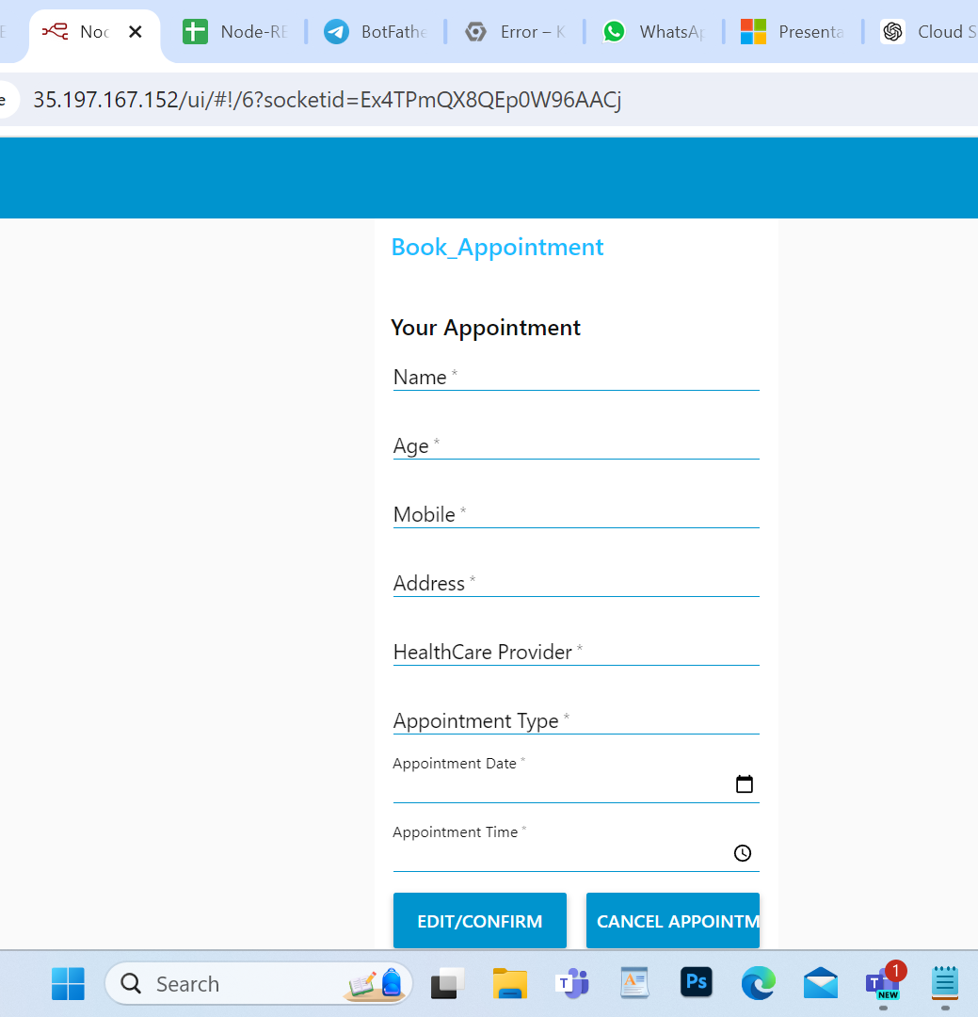
Problem Statement
Challenges
Manual appointment booking processes prone to human error.
Patients lack access to medical records and doctor details.
High administrative costs and labor-intensive scheduling.
BookMyDoc
automates scheduling appointments, cutting down on human error.
Gives people access to their health information.
provide comprehensive data on physicians.
reduces administrative burden, which lowers operating expenses.

Slide 4
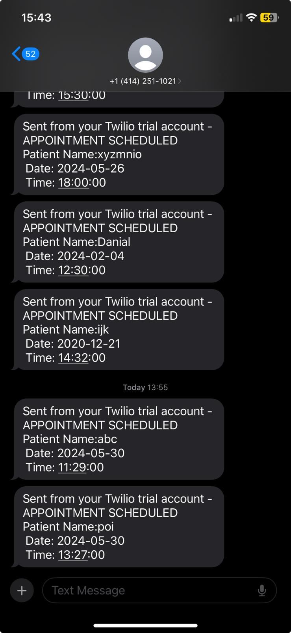
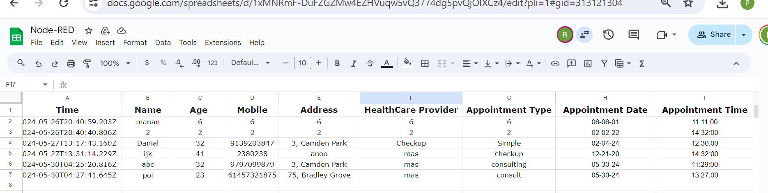
Application Development- what's the significance of the project
The BookMyDoc uses Node-Red application by connecting different cloud services which can make patient and doctor interaction easier.
Significance of App
Simplify Booking Process, Scalable and flexible backend process using cloud
- Reduce Administrative workload, Secure and Reliable
Twilio API:
Able to SMS notifications to confirm and remind patients about their appointments.
Google Sheets API
Manages patient records and appointment data, providing an easy-to-access, flexible, and scalable backend solution.
Telegram Virtual Bot:
This unique API allows users to book appointments through normal chat conversation, and retrieve booked appointments.
Notes:
The Significance of the app is to Simp

Slide 5
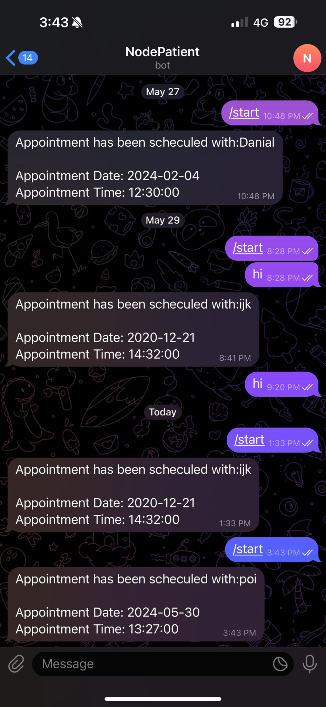
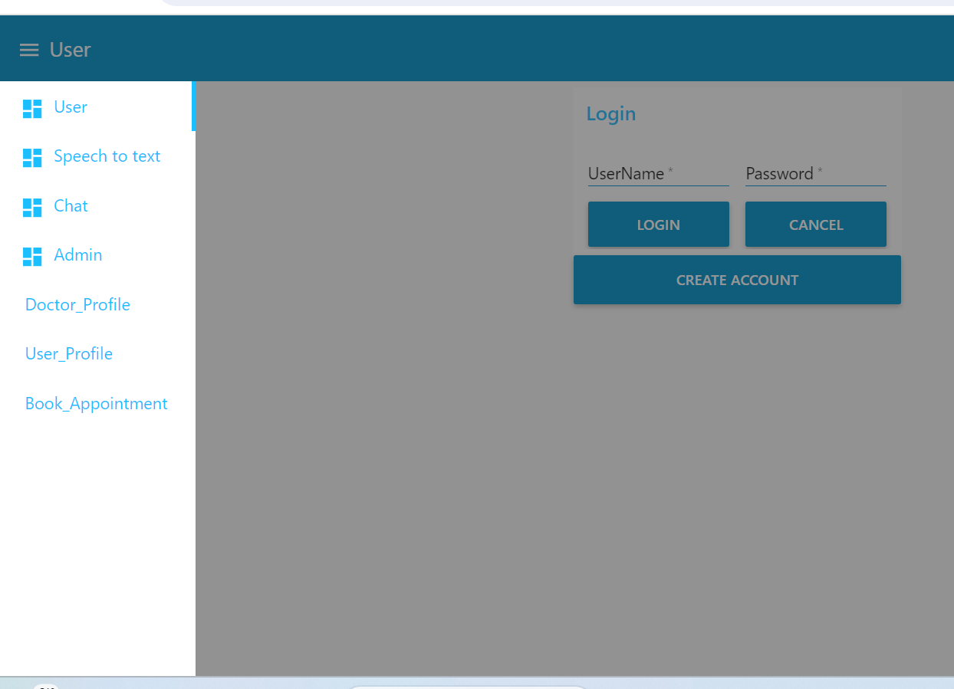
Improvements, Additions , exclusions
We made a new administrator named Admin who can change, remove, and add information about doctors.
Speech to Text and Telegram Watson Tabs are new features that have been added. The fact that they work with Watson services shows that they have advanced features like speech recognition and natural language processing which is not working correctly.
We have changed the UI for "Dashboard" ,"Find Doctor" and "Edit Profile".
Some MQTT broker configurations have been removed. For example, "web" and "local" configurations for MQTT brokers.
We have added new API Telegram Bot from BotFather.

Slide 6

Learning and Reflection
BookMyDoc delivers an effective solution for patient's appointment booking services in healthcare.
Application uses Node-RED application integrated with Google Cloud Platform and API's including Twilio, Google Sheets, and Telegram Bot.
Accessibility is enhanced and administrative load is reduced by improving patient experience.
Future Improvements include Advanced features using AI, develop Mobile App, add multilingual support, etc.
Team Reflection portrays practical experience in Node-RED and cloud services.
Enhanced problem-solving skills with teamwork.
Notes:
Improvements
Feature of AI for personalized recommendations.
A mobile version for wider accessibility.
Multiple language options to reach more audience

